Slide 1
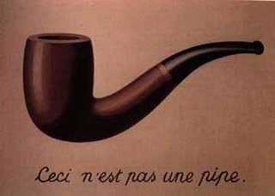
CMN 1160B – Introduction to Media Studies
Week 4B: Theoretical Perspectives on Media Content
Daniel J. Paré
University of Ottawa, Department of Communication
September 29, 2016
Notes:
1

Slide 2
Preview
Representation and Signification
Saussure
Peirce
Barthes
Notes:
2
2

Slide 3

Studying Content
Structuralism
discovering the underlying patterns that shape texts and genres
Semiotics
the science of signs
Post-structuralism
Meaning comes from the decoder

Slide 4

Studying Content
Structuralism
we do not speak language, but rather, “language speaks us.”
tendency to treat individual texts as discrete, closed-off entities and focus exclusively on internal structures.
Propp’s folklore studies - All traditional stories follow the same basic narrative structure and lexical elements (i.e., narrative logic).

Slide 5
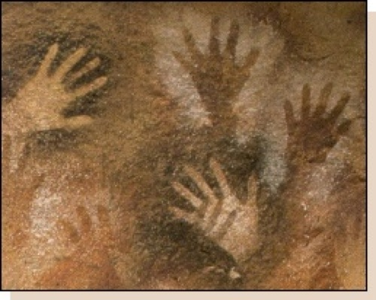
Studying Content
Semiotics
the study of the social production of meaning from signs – i.e., analyze language as system of signs
Central focus: relationship between signs and their meaning
How do verbal & non-verbal signs function? How is meaning generated and conveyed?

Slide 6
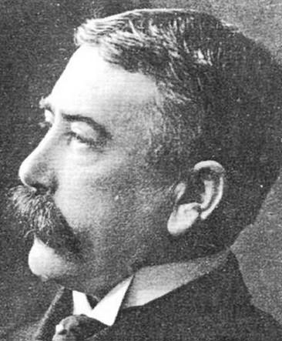
Ferdinand De Saussure (1857-1913)
Notes:
6

Slide 7


Slide 8


Or,
A word such as, “Tree”
Or a picture:
Or a drawing:
Notes:
8

Slide 9
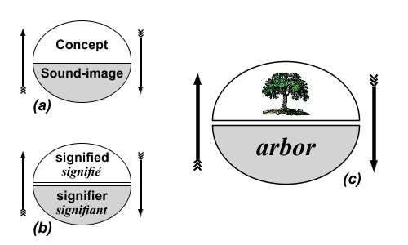
Saussure’s Model of a Sign

Slide 10
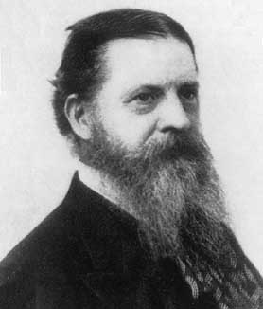
Charles S Peirce (1839-1914)
Notes:
10

Slide 11

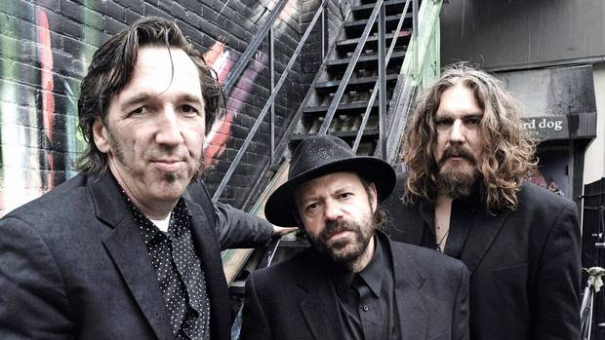
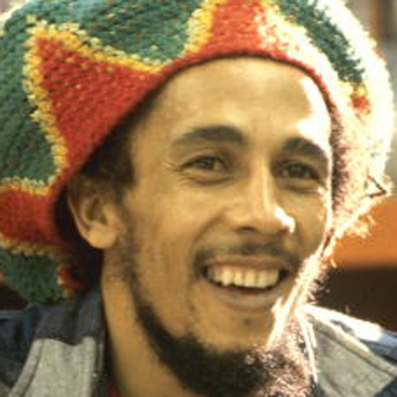
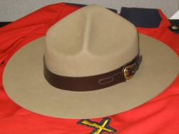




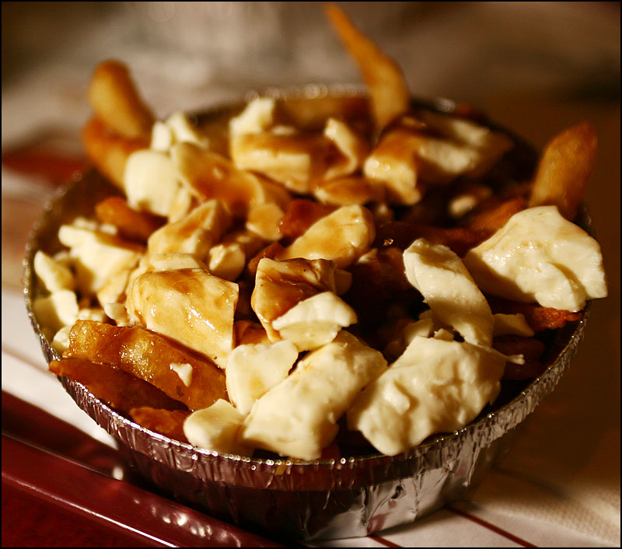
Not all signs are equal….
Icons: closely related to, and resembles what is being represented
Index: related to what is being represented, but not directly
Symbol: No direct link to what is being represented; purely connotative
Notes:
11

Slide 12
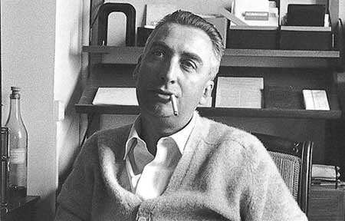
Roland Barthes (1915-1980)
Notes:
12

Slide 13
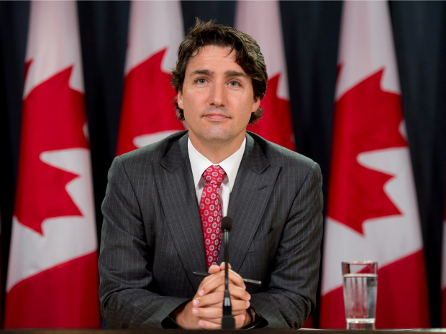
Notes:
13

Slide 14
